Slide 1
Q 03
Time allowed: 20 minutes
In Kerberos, what data structures are used to authenticate a user to the application server? What is contained inside of them? What is their purpose? Briefly discuss how they are protected.

Slide 2
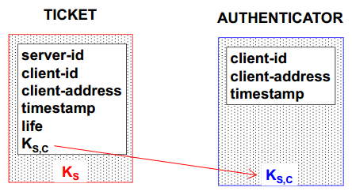
Solution
The two data structures used are
Authenticator
Ticket
Ticket is used for getting the service from the Application Server where as Authenticator is used by the client to authenticate itself to Application server. The structure of each data structure is given.

